Slide 1
Web Application Frameworks
Why web apps?
A first Python web app with Django

Slide 2
Web Servers and Clients
A basic web server can be a computer running web server software, plus the content for the site
More common to have multiple computers sharing the work
The server listens for requests from clients
The client is most likely a web browser e.g. Chrome
In response to each request, the server sends a response back to the client
page1.html
page2.html
Client
(web browser)
Can I have page1.html ?
here's page1.html
Server
Can I have page2.html ?
Can I have page5.html ?
Another client
(web browser)
404 ☹
Another client
(web browser)
here's page2.html

Slide 3
Web Server Software
Apache
https://httpd.apache.org/
Ngnix ('engine x')
https://www.nginx.com/
Apache and Ngnix are cross-platform but most commonly run on Linux/Unix servers
Microsoft IIS (Internet Information Services)
https://www.iis.net/

Slide 4
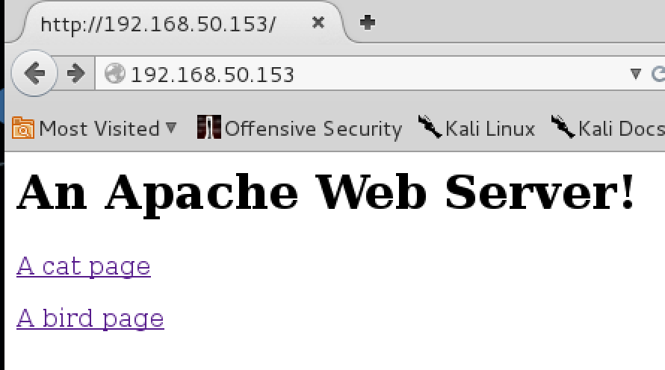
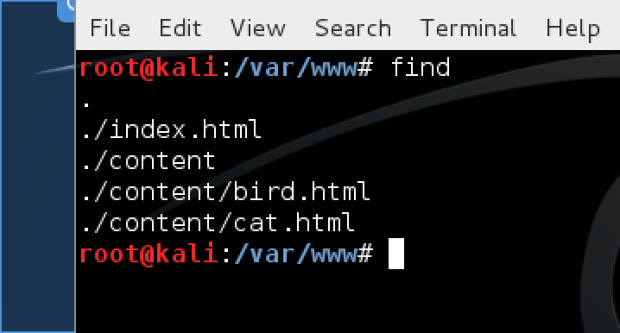
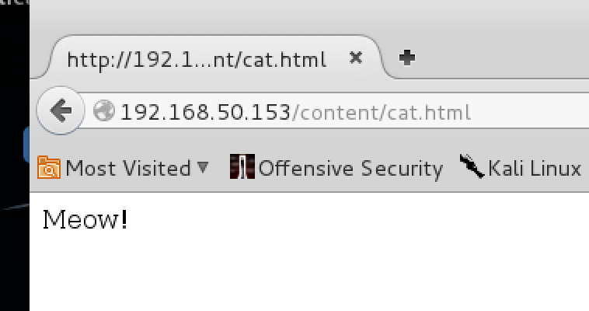
For a really basic web server, you would…
Install and start your web server software (e.g. Apache)
Place web site resources that you wish to serve – html, CSS, JavaScript – in a designated directory (commonly /var/www on Linux)
Organize resources into directories
Directories in /var/www/ become
paths to resources

Slide 5
For anything more than a static site, will need some or all of the following…
A database
A way to handle sessions and users
For example, as user adds items to shopping cart
Or, when user logs in (authenticates) and accesses information specific to them
Server configuration
SSL support
Logging, monitoring, reporting, analytics
Security of web server
Content management

Slide 6
Databases, Programming Language
Apache lends its name to the LAMP stack
Linux-based operating system
But can also be
Windows -> WAMP stack
MySQL database
or PostgreSQL or SQLServer…
Apache web server software
Ngnix ("engine-x") is replacing Apache for many servers
PHP programming language
Server-side scripting
Or Perl or Python

Slide 7
Components are changeable
No requirement to use Linux+Apache+PHP+MySQL : very common to replace components as needed, for your own requirements
PHP handles server-side logic – for example, what happens when you fill in a form and click submit
That's the 'classic' website model
Robust, scalable, historically very common
Can move database onto another physical computer – or computers
Can add more web servers – a cluster - to share the workload as site grows. Requires load balancing to divide work

Slide 8
Web servers are really good at serving resources (web pages, images…)
But they have a harder time dealing with complex application logic
Imagine a large website
For example, Amazon, eBay, Twitter…
A web server can struggle to handle all of the tasks required
Plus, you might want to use the application logic in other places outside of your website

Slide 9
http://www.javaworld.com/article/2077354/learn-java/app-server-web-server-what-s-the-difference.html
As an example, consider an online store that provides real-time pricing and availability information. Most likely, the site will provide a form with which you can choose a product. When you submit your query, the site performs a lookup and returns the results embedded within an HTML page. The site may implement this functionality in numerous ways. I'll show you one scenario that doesn't use an application server and another that does. Seeing how these scenarios differ will help you to see the application server's function.
Scenario 1: Web server without an application server
In the first scenario, a Web server alone provides the online store's functionality. The Web server takes your request, then passes it to a server-side program able to handle the request. The server-side program looks up the pricing information from a database or a flat file. Once retrieved, the server-side program uses the information to formulate the HTML response, then the Web server sends it back to your Web browser. To summarize, a Web server simply processes HTTP requests by responding with HTML pages.
Scenario 2: Web server with an application server
Scenario 2 resembles Scenario 1 in that the Web server still delegates the response generation to a script. However, you can now put the business logic for the pricing lookup onto an application server. With that change, instead of the script knowing how to look up the data and formulate a response, the script can simply call the application server's lookup service. The script can then use the service's result when the script generates its HTML response.
In this scenario, the application server serves the business logic for looking up a product's pricing information. That functionality doesn't say anything about display or how the client must use the information. Instead, the client and application server send data back and forth. When a client calls the application server's lookup service, the service simply looks up the information and returns it to the client.
By separating the pricing logic from the HTML response-generating code, the pricing logic becomes far more reusable between applications. A second client, such as a cash register, could also call the same service as a clerk checks out a customer. In contrast, in Scenario 1 the pricing lookup service is not reusable because the information is embedded within the HTML page. To summarize, in Scenario 2's model, the Web server handles HTTP requests by replying with an HTML page while the application server serves application logic by processing pricing and availability requests.

Slide 10
Web Server vs. Web Application Server
So, you might have a web server which handles incoming requests
Web server will serve static content – CSS, images, client-side JavaScript…
And, web server will pass requests that require application logic (e.g. database queries) to application server
When application server returns response to web server, it will be used to create a HTML page that will be served to the client

Slide 11
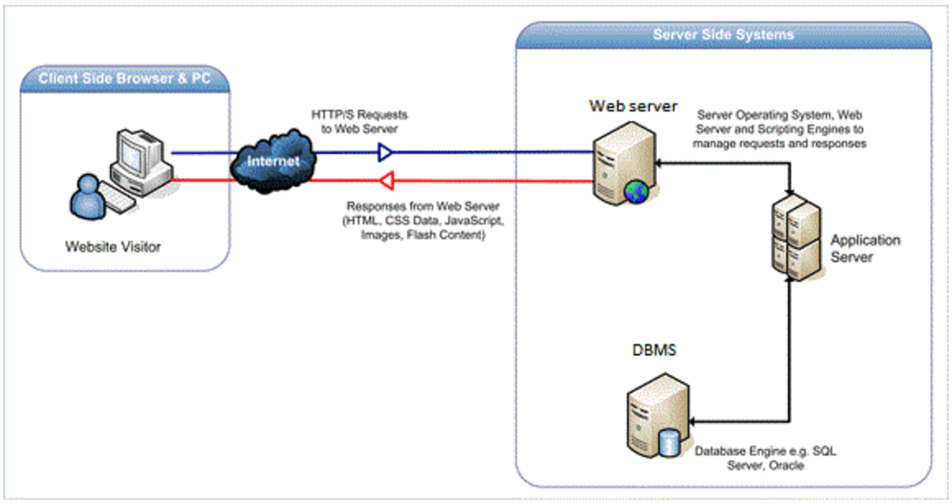
Web application server
http://stackoverflow.com/questions/936197/what-is-the-difference-between-application-server-and-web-server. Original image from ??

Slide 12
Web Application Frameworks
Creating web sites tend to involve similar tasks
Fetching info from database and displaying in web page
Handling form input
Authentication
Sessions
Security/SSL
Internationalization
Testing
many others…..
Web application frameworks provide libraries to help with common tasks encountered when building websites
So, you can build your app using a web application framework

Slide 13
Web Application Frameworks
Ruby on Rails
ASP.NET (C# or Visual Basic)
CakePHP (PHP)
Django, Flask, Pyramid (Python)
JavaServer Faces, Spring, Struts, Grails, Play (Java)
Express, Hapi (JavaScript)
In no particular order; designed for different types of applications.
And, MANY others!

Slide 14
Web Application Frameworks
Your web application is often created using a web application framework
Application runs on your web application server; taking requests from the web server; executes application logic
Almost always communicates with a database
Web server will serve
static resources
web pages generated by your application
to your clients
http://stackoverflow.com/questions/936197/what-is-the-difference-between-application-server-and-web-server. Original image from ??

Slide 15
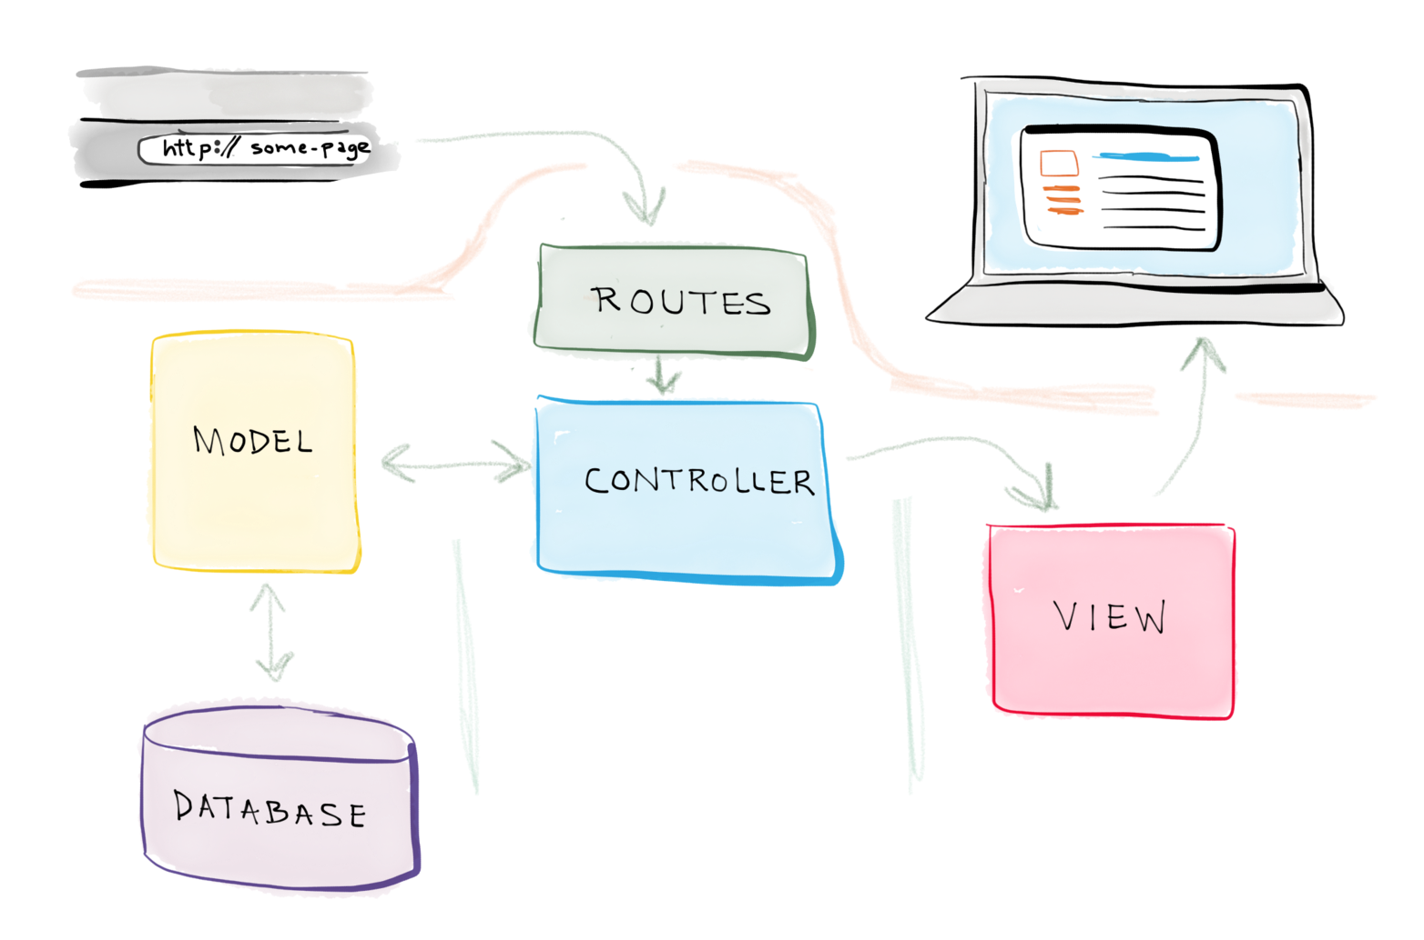
Web Applications
Many web application frameworks use a Model – View – Controller or MVC architecture
Model = database
View = web pages
Controller =
application logic
Various derivative/variations
on the MVC architecture
https://realpython.com/blog/python/the-model-view-controller-mvc-paradigm-summarized-with-legos/

Slide 16
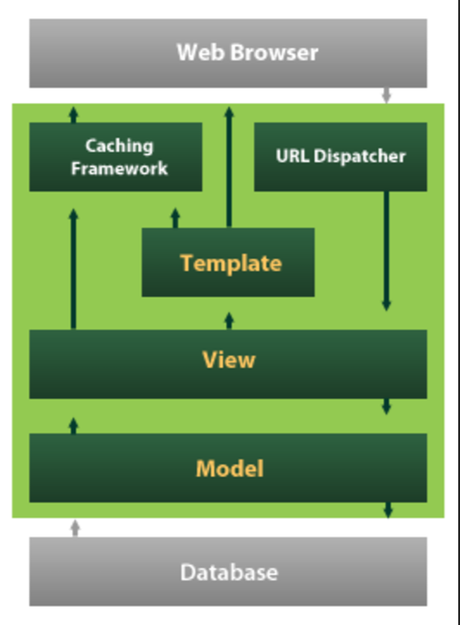
Including with Django…
Which calls controllers 'views'
and calls views 'templates'
It's still a MVC architecture, just with slightly confusing names

Slide 17
Communications between client and server
Communications use HTTP: HyperText Transfer Protocol
Or HTTPS – HTTP over SSL (secure socket layer), verification you are connected to the site you think you are connected to, and data is encrypted
You application code is usually identical, whether it's served over HTTPS vs. HTTP; more of a web server concern than a app development concern
So, need to know some HTTP basics

Slide 18
HTTP
Important to understand what HTTP is made of
Client and server
HTTP requests and responses
URL components: paths and query strings
Methods
Status codes
Important reading: article such as this one http://code.tutsplus.com/tutorials/http-the-protocol-every-web-developer-must-know-part-1--net-31177

Slide 19
HTTP Requests/Responses
Client makes a HTTP request
Server will reply with a HTTP response
Client is commonly a web browser but lots of other things 'speak' HTTP, like
any other application - programming languages have HTTP libraries
a mobile app
tool like curl or wget, network analysis tools; fiddler, Wireshark
Selenium, browser automation or testing tools
The client and server don't have to request/send web pages
All kinds of information can be communicated with HTTP
Example: when the browser requests an image, stylesheet
Servers often communicate with other and send data over HTTP
HTTP is a VERY common protocol

Slide 20
HTTP Requests/Responses
Client makes a HTTP request
Server will reply with a HTTP response
Example HTTP request: the client may request the server gets a web page at a particular URL, e.g. http://www.bbc.com/news
The www.bbc.com server will examine the request, and figure out what web page should be sent in response
The response is commonly a HTML page
But it can be a CSS file, script, image, other media, JSON…

Slide 21
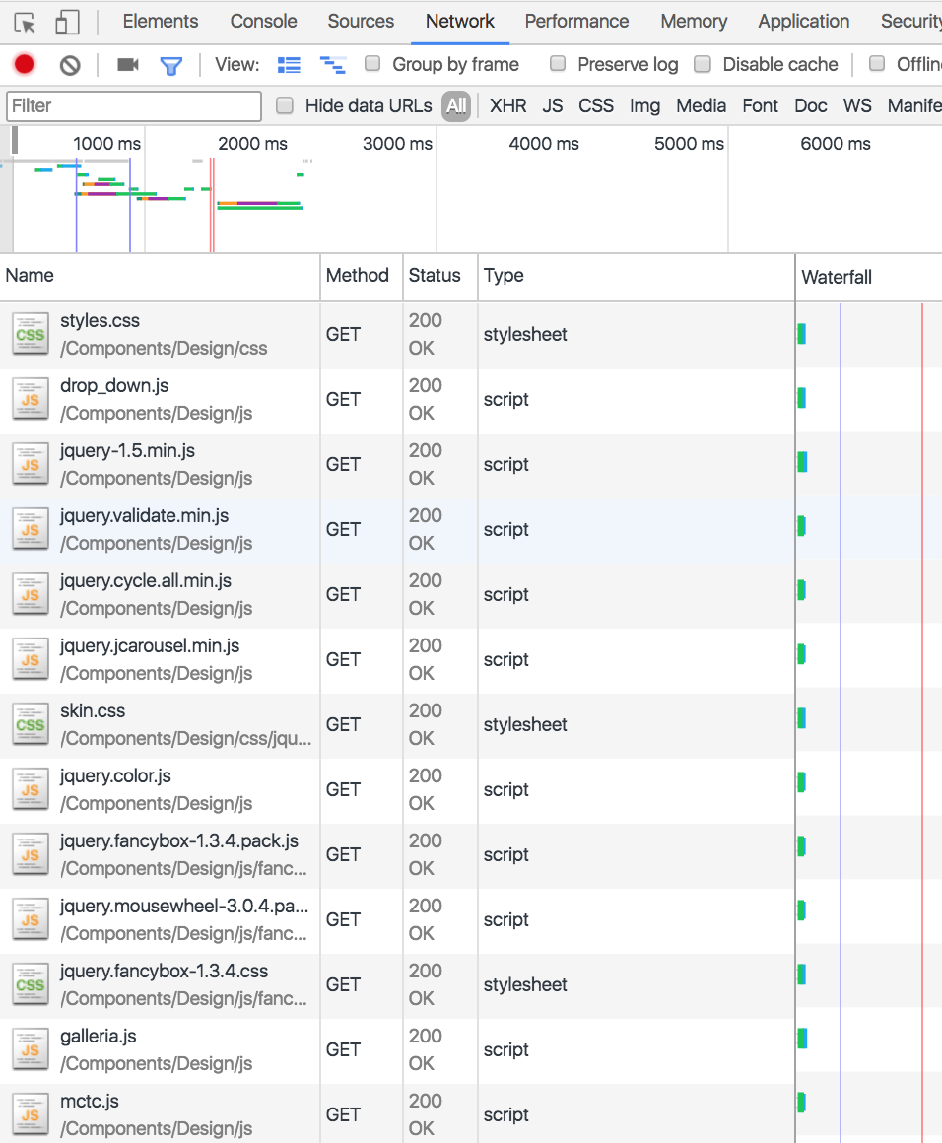
HTTP Requests/Responses
The client reads the HTML web page response
This page may include images, stylesheets, scripts…
<link rel="stylesheet" href="style.css">
<img src="welcome.jpg">
<script src="time.js"></script>
So the client sends another request to the server, one for each resource
For each request, the server sends the resource in response
The client renders the page as the responses are received
Some of the requests and responses for resources in MCTC's home page.
Network tab, in Chrome developer tools

Slide 22
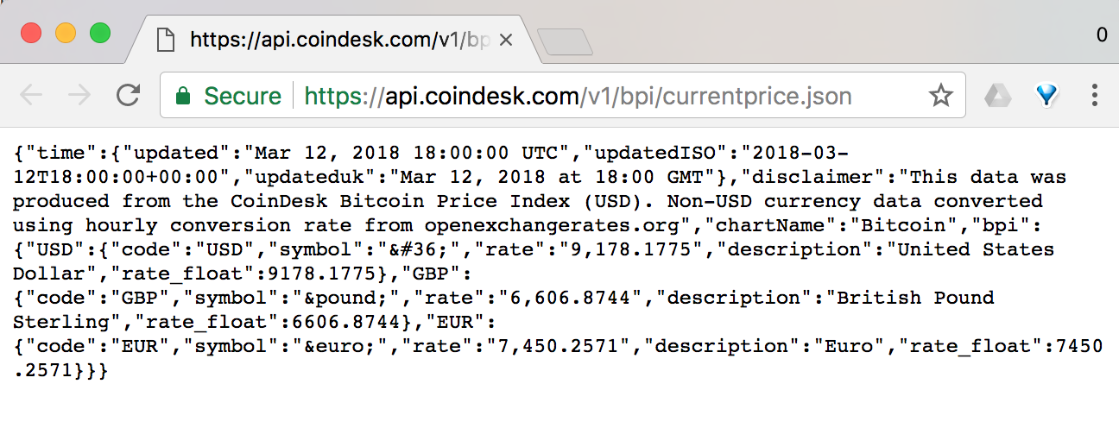
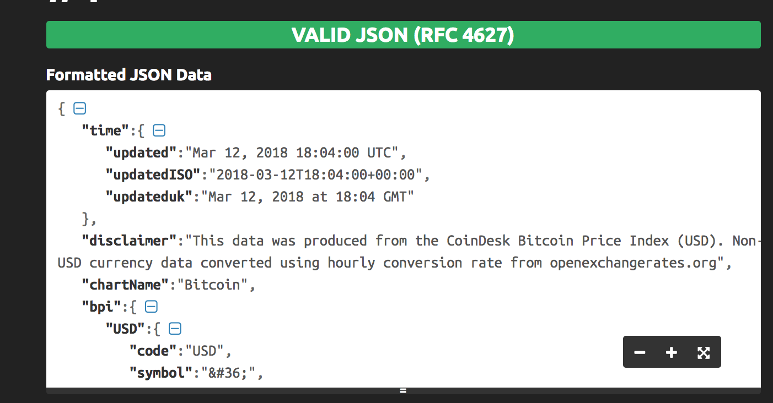
HTTP Requests/Responses: APIs
Clients and servers aren't limited to to web pages and related resources
Servers can communicate with other and send data over HTTP, often using JSON responses
For example, can make a HTTP request to this URL, and receive a JSON response including the current price of Bitcoin - try this URL in your browser
https://api.coindesk.com/v1/bpi/currentprice.json
But, you can also make this request programmatically, and work with the JSON response in your code (in JavaScript and/or just about any other programming language)
For example, you could build a web application that notifies users when the price of Bitcoin goes above or below a certain threshold
An API (application programming interface) server provides JSON responses
An API server may also be constructed using a web application framework
Your browser can also make API requests to a web server, used to update a page once it's loaded - AJAX or as part of a front end framework e.g. Angular, React, Vuejs…
Tip: Use a JSON formatter tool to make it easier to read the response, e.g. https://jsonformatter.curiousconcept.com

Slide 23
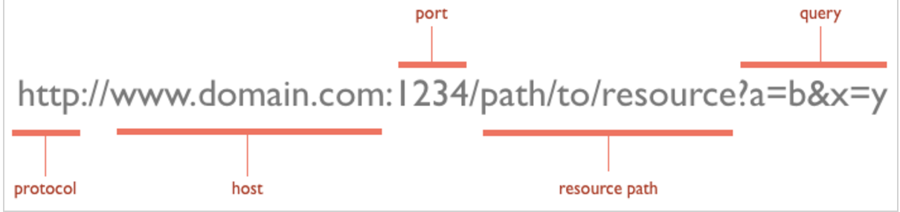
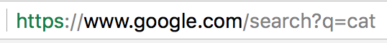
HTTP Requests: URLs and Methods
A HTTP request must include a URL
A URL has several components. It must include a protocol, port, and host
A URL may have a resource path
The URL may have a query (aka query parameters)
Protocol
https
Query parameter q=cat
If the protocol is not provided, your browser will assume it's http.
If the port is not provided, your browser will assume it to be 80 for HTTP and 443 for HTTPS, the most common defaults, and make the correct request
Host www.google.com
Path
search

Slide 24
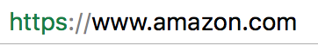
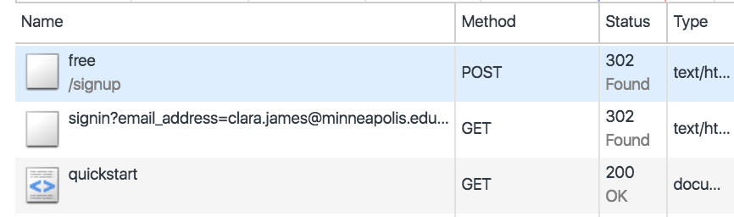
HTTP Requests: URLs and Methods
A request must include a method to indicate what type of request it is
The method is needed by the server, to figure out how to respond
There's a lot of methods, but the most common are...
GET: fetch a resource from server (optionally include data in the URL using query parameters)
POST: server, here's some data to save (data sent in request body)
PUT: server, replace a resource with this data
PATCH: server, update a resource with this data
DELETE: server, delete this data
GET and POST most common, browsers know how to make these
GET requests for fetching resources, e.g. HTML, stylesheets, images
POST for modifying data on the server
signing up for fixer.io API
Notice POST and GET requests

Slide 25
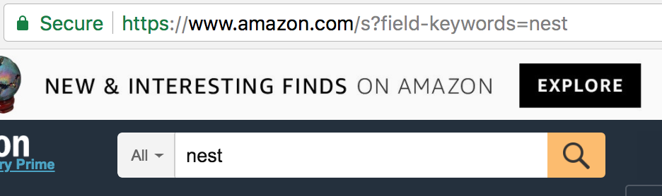
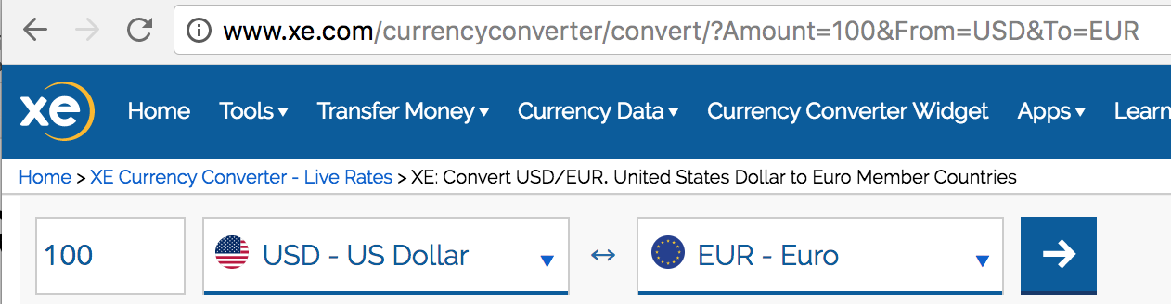
HTTP Requests: URLs and Methods
A GET request is made to fetch a page, script, stylesheet, image…
Anything typed into the address bar of a browser is sent as a GET request
By default, forms send data as GET requests, e.g. Google search, other lookups and queries. Notice the form data in the URL

Slide 26
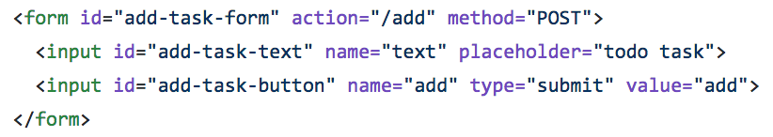
HTTP Requests: URLs and Methods
Users don't directly create POST requests. The most common way to create a POST request is with a form with method="post" attribute
The data is carried in the body of a POST request, not the URL
The request body can include file uploads
The data in the body can be encrypted
A POST request can't be bookmarked or generated from an URL. Important to prevent duplicate form submissions or inadvertent data modification
The maximum amount of data that can be sent is much larger than GET (GET has a limit of ~2000 characters)
When working with forms, use POST for
Anything that modifies data on the server (e.g. creating an account, making a purchase, making a new GitHub repository, editing a social media post…)
Uploading files
Sending any data that should be private, for example logging in
Large amounts of form data
method="POST" attribute
It's not case sensitive
method="post" works too
What's wrong with this?

Slide 27
HTTP Requests/Responses
A response is sent by the server in response to a request
The response can contain many parts, most common are
Headers (required): metadata about the response, including
Content-Type: what type of data is this? Text/HTML, JSON, stylesheet, image…. Used by the client to figure out what to do with the response
Content-Length: the size of the response in bytes Many other header fields, https://en.wikipedia.org/wiki/List_of_HTTP_header_fields
Body (optional): the data of the response, which may be a HTML page, script, JSON, image, other media….
A status code (required): indicates if the request was successful or not, or if the client needs to do more work to complete the request

Slide 28
HTTP Requests/Responses
Many status codes, but common ones include
2xx = ok. 2xx messages indicate success
200 ok, used for many types of request
201 created. Often sent in response to a POST
3xx = the client needs to do more work to complete the request
302 redirect. e.g. after logging in, redirect to customer's profile page
4xx = client errors – for example, client has requested something that is not available, or they are not authorized to request
401 unauthorized. Client needs to authenticate (log in)
403 forbidden. Client may be logged in but does not have permission to perform this action (e.g. delete someone else's data)
404 not found
5xx = server errors
500 internal server error, a general error message
503 service unavailable
There's more to HTTP requests and responses than this, but these are the most important parts you need to know about right now.

Slide 29
Important to understand the structure of a HTTP request & response
You need to understand how to make a request, and how to create the right response
And, it's very useful for programmers to understand network topics
Important for programmers to understand the environment in which your code will run
http://www.sw-engineering-candies.com/blog-1/top10thingseverysoftwareengineershouldknow#TOC-Understand-the-Infrastructure

Slide 30
Django
Python Web Application Framework
Used by Instagram, Bitbucket, Pintrest, The Onion, Mozilla, National Geographic, NASA, Venmo…
https://www.djangoproject.com/start/overview/
http://ddi-dev.com/blog/programming/top-sites-built-django-framework/
An opinionated web framework - there is usually one Django way to do things
A lot of structure, which makes it good for larger sites
Compare to Flask

Slide 31
First Django Site: Travel Wish list
User can enter the names of places they want to visit
Will have a visited button to click, to check off a place
Can view list of places that the user wants to visit
And a list of places that they have visited
https://github.com/claraj/django_travel_wishlist

Slide 32
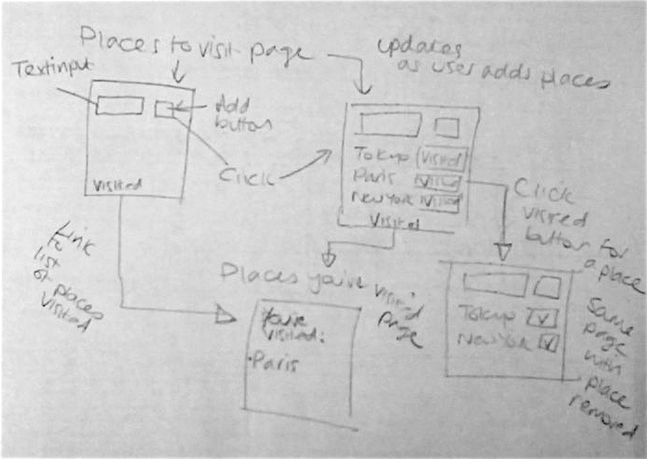
Design
Sketch out the pages you want; what components will they have?
How will the user move between pages?

Slide 33
Create Project
Create new directory called django_wishlist
In the django_wishlist directory:
Create and activate a new virtual environment; specify Python 3 if you have more than one python on your computer
Install django with pip install django

Slide 34
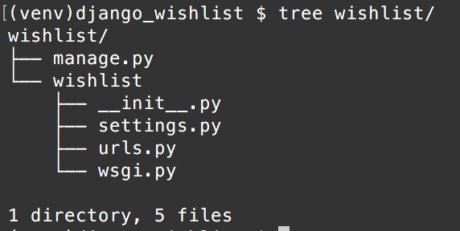
Create Project
From the django_wishlist directory, type
django-admin startproject wishlist
This will create the following files:
Open the project in your editor.

Slide 35
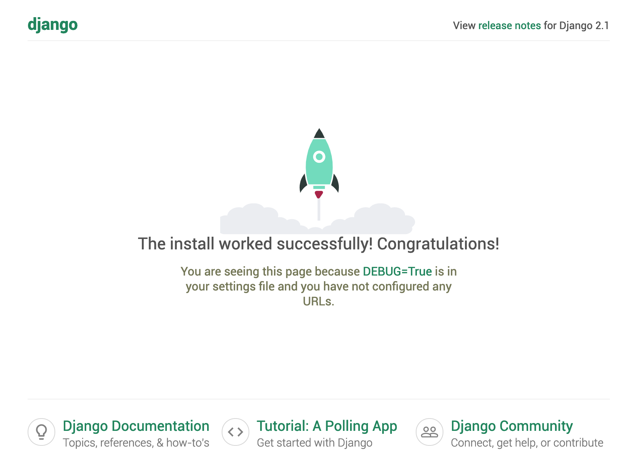
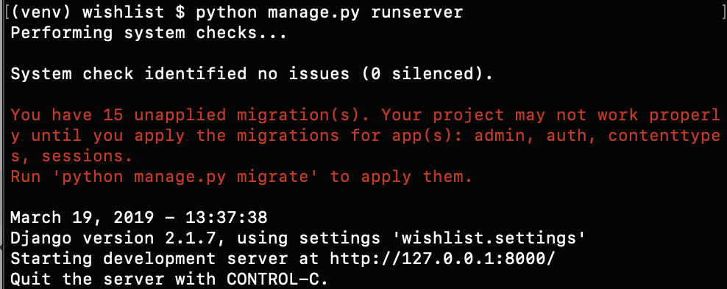
Run server
Verify you are in the wishlist directory and type
python manage.py runserver
Go to http://127.0.0.1:8000 in your browser
To stop server, press Ctrl+C
You can ignore the "unapplied migrations" warning, we'll fix that soon

Slide 36
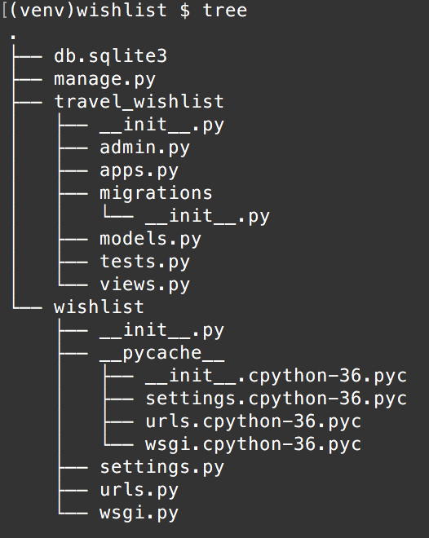
Creating an app
Each part of your website is an app
We only need one app in our project
Stop your server with Ctrl+C and create an app with
python manage.py startapp travel_wishlist
Which will create some more
directories and files in your project

Slide 37
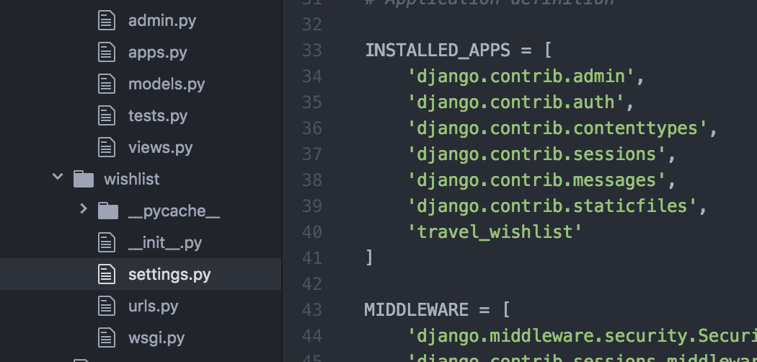
Add travel_wishlist to settings.py
settings.py has high-level settings for the project
Open wishlist/wishlist/settings.py
Find the INSTALLED_APPS list
Add 'travel_wishlist' to the end

Slide 38
First page
The page should display a list of places
And, a form with a text input to type a new place name, and an add/submit button
Let's make this the home page of the app
To display a page, we need to decide on
the url for a request for this page
a view, the code that figures out what data to display on the page (and may talk to a database), which creates a response
and a template - used to create a response - HTML to be displayed, usually with placeholders for the view to populate with data

Slide 39
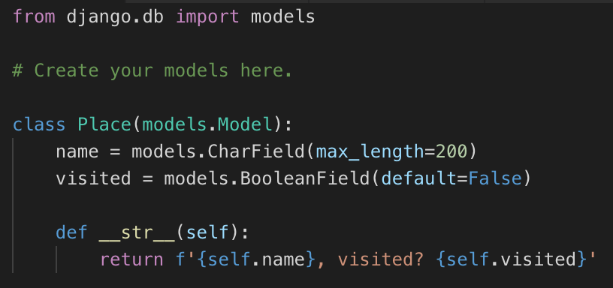
Place Model
Django has a built-in ORM, similar to PeeWee or SQLAlchemy
In wishlist/travel_wishlist/models.py, add a Place model with two fields – the place's name, and whether the user has visited it or not.
This describes a Place table in the database, with a name column, and a visited column
Notice can add constraints, default values, to the columns
wishlist/travel_wishlist/models.py

Slide 40
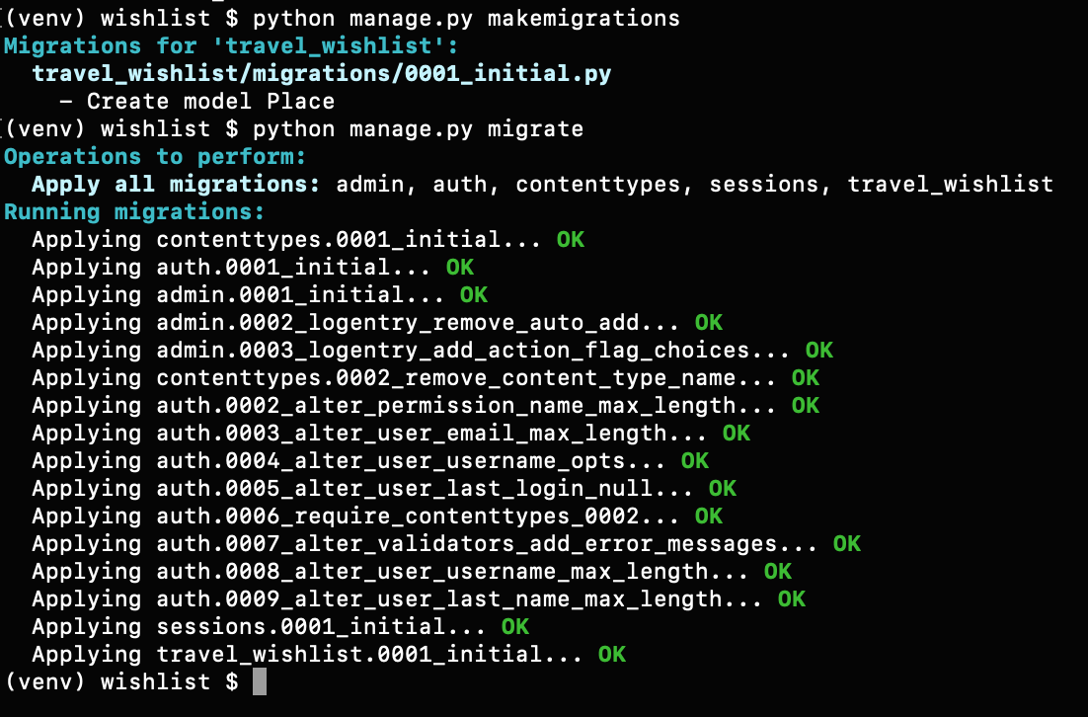
Migrations: Creating database tables for your models
Save the models.py file. In the console, type
python manage.py makemigrations
python manage.py migrate

Slide 41
Primary keys
Django automatically creates a column called pk for each model/table
pk is the primary key for your table
By default, pk is an auto-incrementing integer
Can override and define your own primary key if needed, but the Django default is usually sufficient

Slide 42
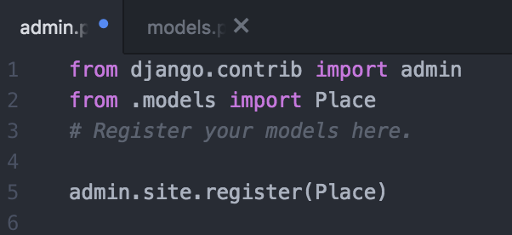
Register your models with the admin console
Django's admin console can be used to view and manipulate data in the database
Open wishlist/travel_wishlist/admin.py
Add this code

Slide 43
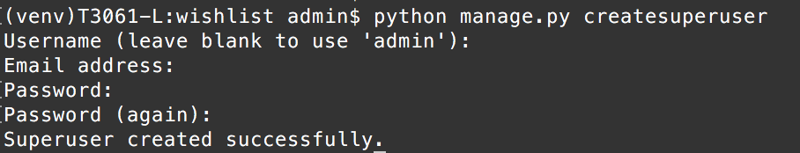
Accessing the admin console
Need to make an admin user first
Stop your server, if it's running
Type
python manage.py createsuperuser
email address can be empty, need username and password. Remember these credentials

Slide 44
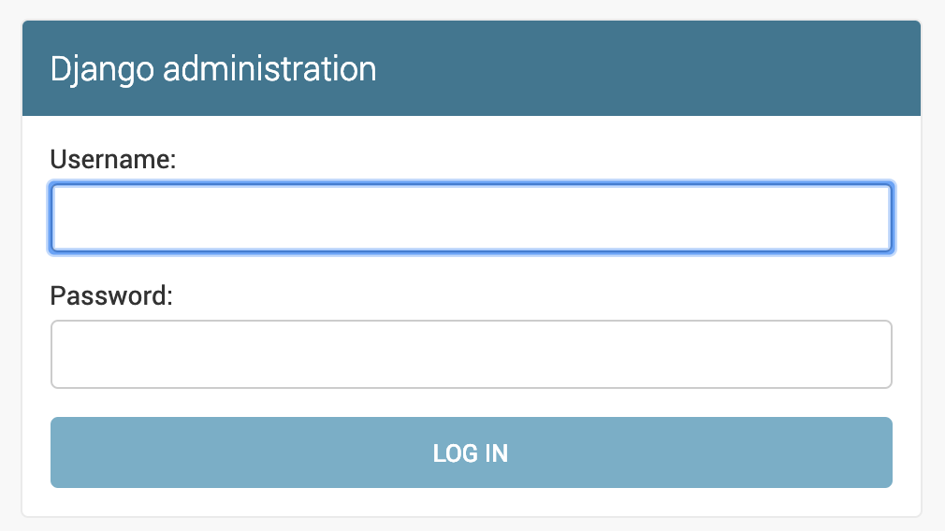
Admin console
Start your server again
python manage.py runserver
Go to
http://127.0.0.1:8000/admin
Log in with the admin username and password you just created

Slide 45
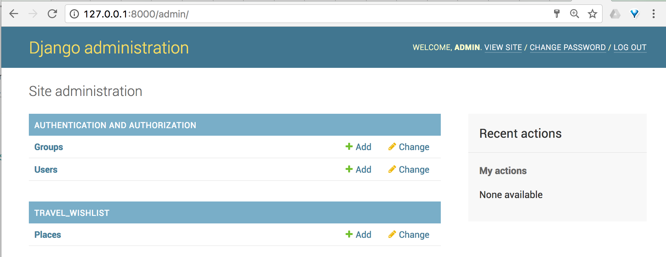
Admin console
Can create and manage users; add and manage data from your database
Only models that are registered in travel_wishlist/admin.py will be available in the admin console
Click here

Slide 46
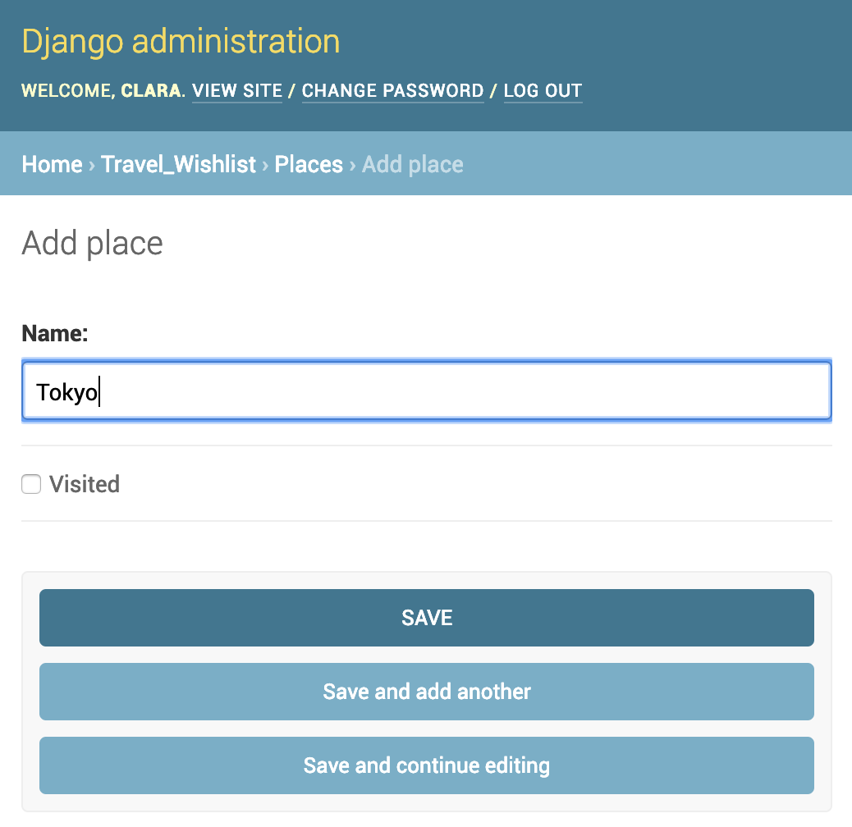
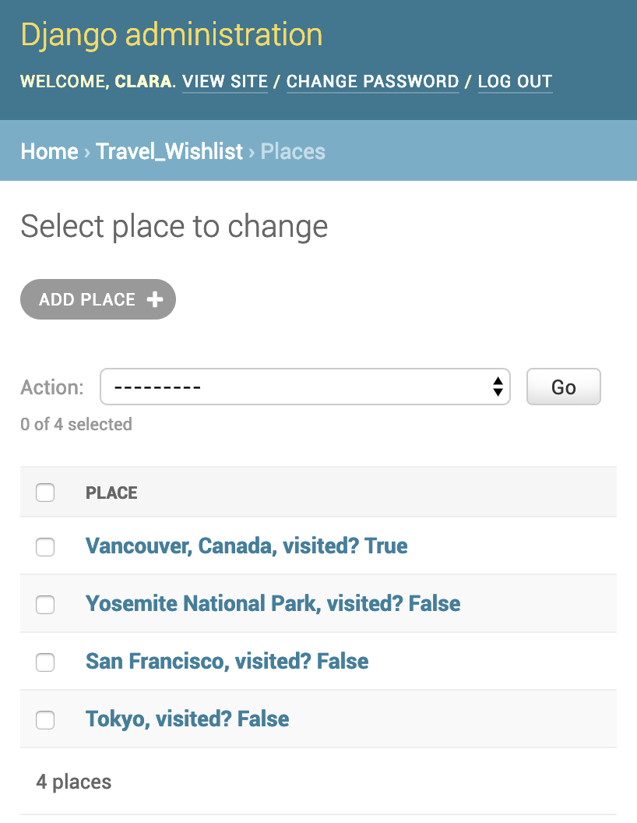
Click on the add button next to Places
Add some example place names
Some visited, some not

Slide 47
Back to code: The list of places page
Reminder: this page should have
a form to add a new place
A list of the places the user has not visited yet
And we need to decide/create
The URL for this page: let's make this the home page of our site
The view: code to fetch the list of not-visited places from the database, and create a response including these places
The template: HTML with the form and a placeholder for the list of places

Slide 48
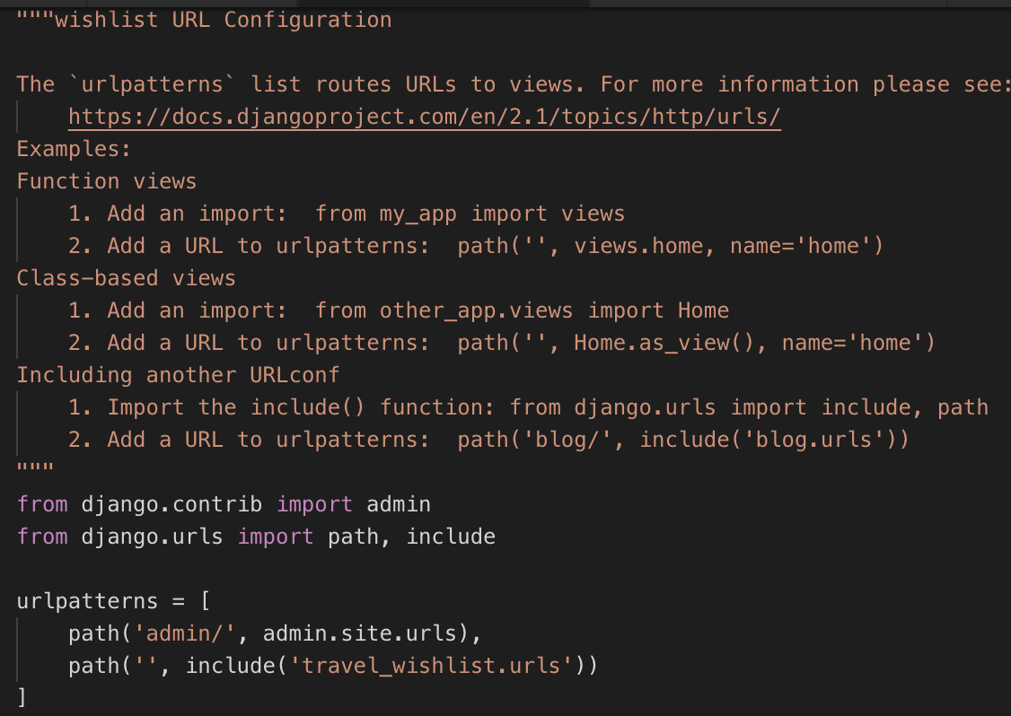
Routing: Create a URL
wishlist/urls.py is the main file for routing requests for your whole site
Tell it to delegate all requests (other than to admin/) to travel_wishlist app
Your app will crash because travel_wishlist.urls doesn't exist yet, so let's create it

Slide 49
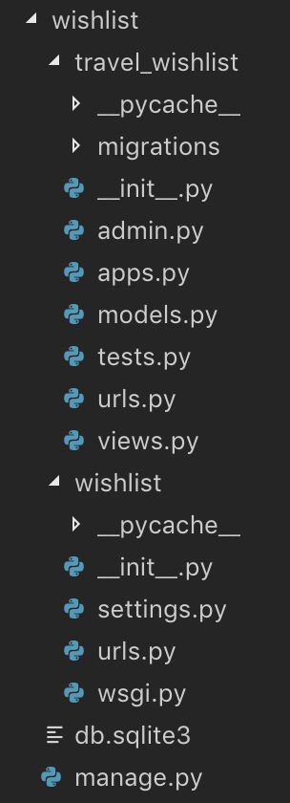
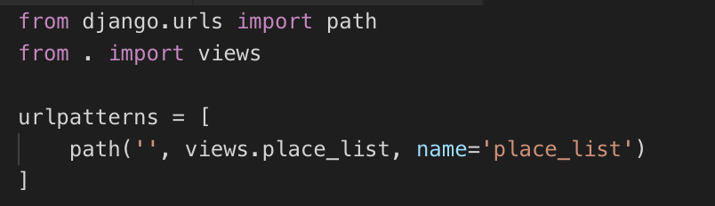
Create new file wishlist/travel_wishlist/urls.py
In wishlist/travel_wishlist directory, create a new file called urls.py
Add the following code
You edited this file on the previous slide
It's still going to crash - AttributeError for place_list

Slide 50
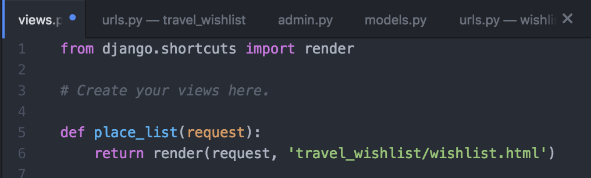
wishlist/travel_wishlist/views.py
Add this code: this view will handle requests to your home page

Slide 51
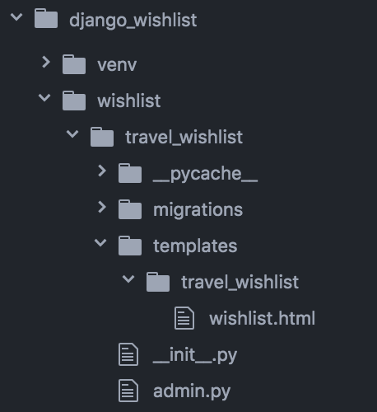
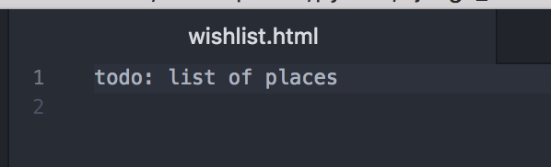
Create the template
In travel_wishlist, create a directory called templates
in templates add a directory called travel_wishlist
In templates directory, create a file called wishlist.html
Add this text ->

Slide 52
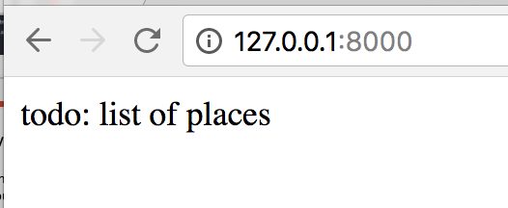
Start your server
Notice that if the server is running, it will (usually) re-start every time you change your code
The home page of your site, at 127.0.0.1:8000 should show this message

Slide 53
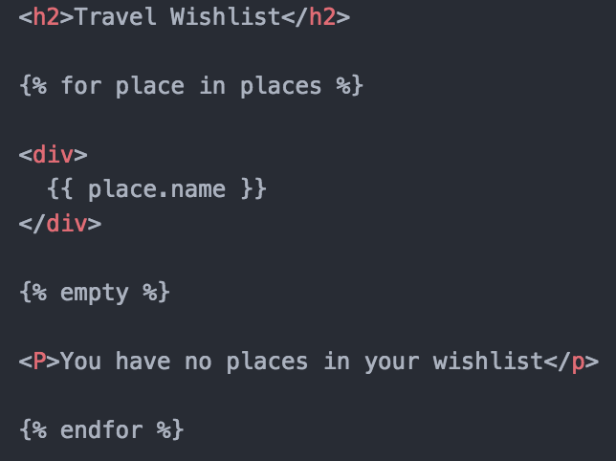
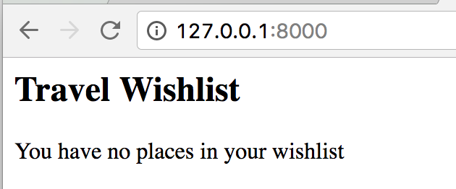
Work on template templates/travel_wishlist/wishlist.html
Replace the text with this, reload your page
Carefully follow the template syntax, watch the { }

Slide 54
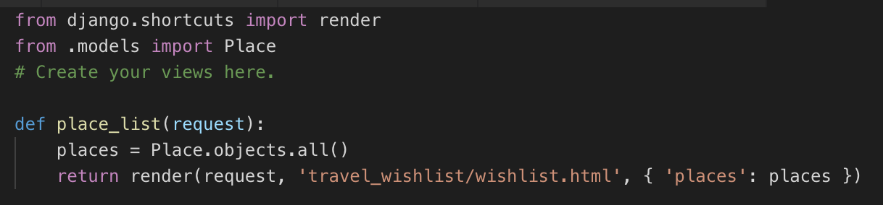
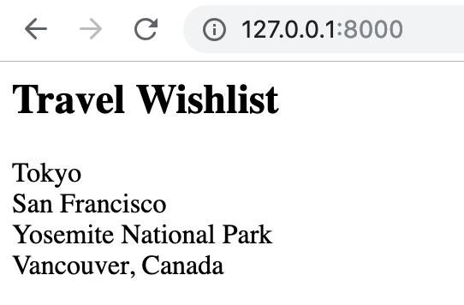
Work on view travel_wishlist/views.py
Fetch the data from the database and display it in the view

Slide 55
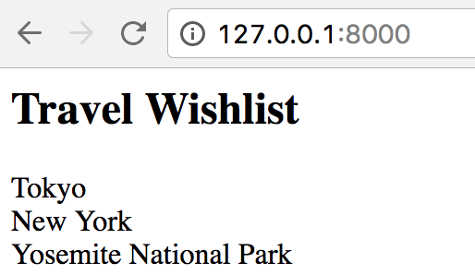
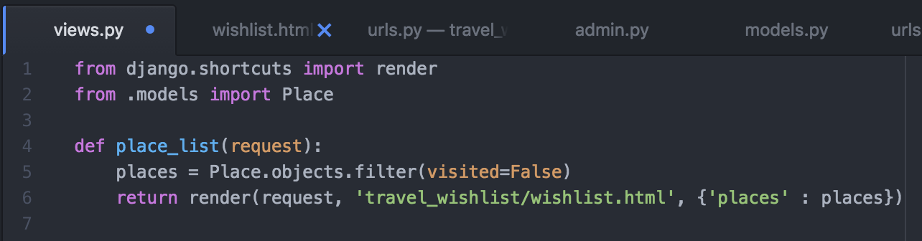
Work on view travel_wishlist/views.py
But a wishlist should only display places the user has not visited
Replace all() with a filter to only show visited=False

Slide 56
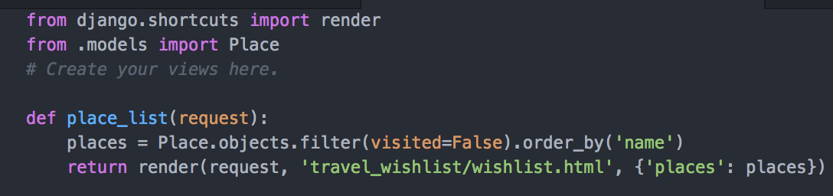
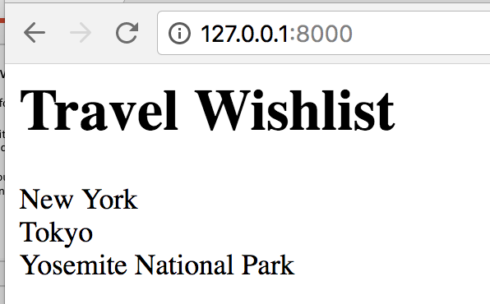
Work on view travel_wishlist/views.py
To sort by name, chain the order_by method
Place.objects is a Manager. A manager lets you run queries against the table and returns QuerySet objects. A QuerySet represents a set of objects from the database. More info here
https://docs.djangoproject.com/en/2.0/topics/db/queries/

Slide 57
A form to add a new place
When you need a form that's for entering data to go in a database…
Create a form object, and tell it that it relates to the model for the new object you want to create…
Django will make a form for you, with the correct number and types of input fields
And deal with basic validation
Magic!

Slide 58
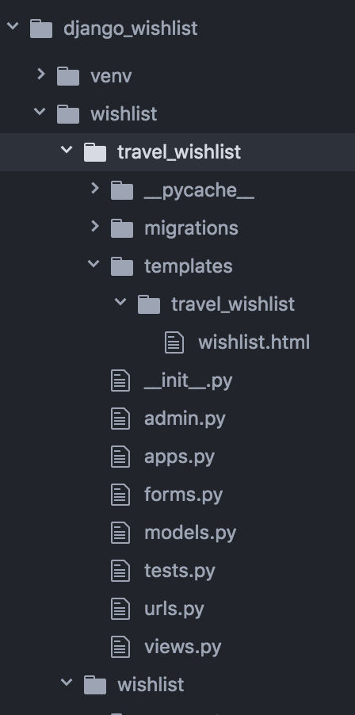
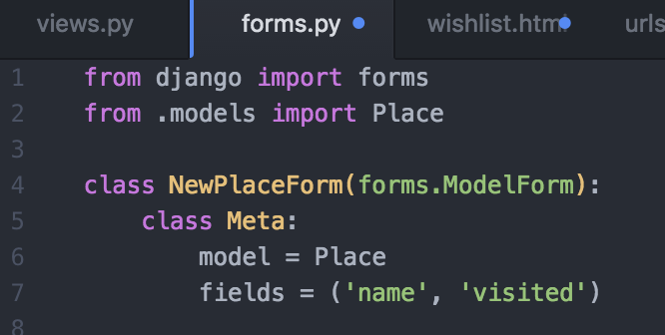
Create new file to describe forms
wishlist/travel_wishlist/forms.py
Add code below

Slide 59
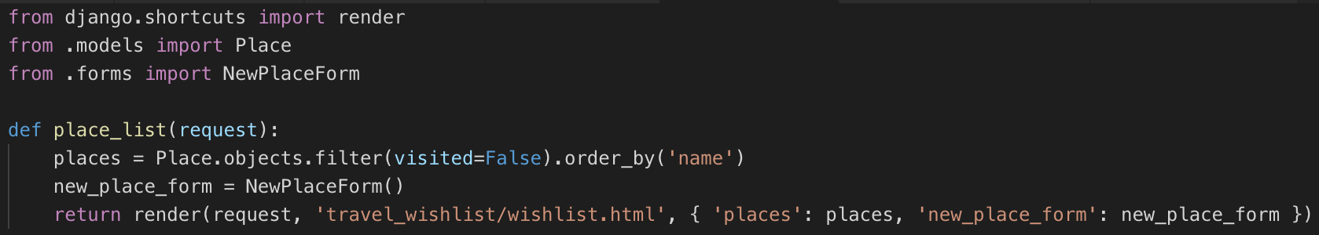
Edit the view, create and provide a form object
wishlist/travel_wishlist/views.py
Django will make a form object that will be rendered as HTML in the page by the template engine

Slide 60
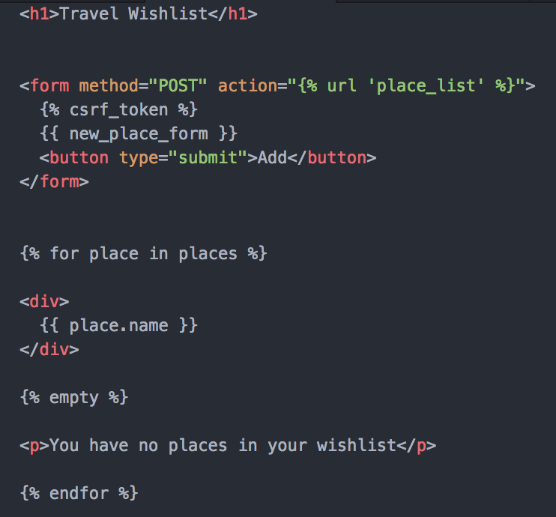
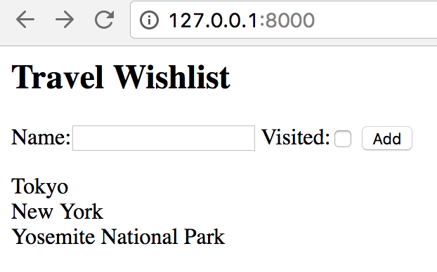
wishlist/travel_wishlist/templates/travel_wishlist/ wishlist.html
Edit your template
Reload your page

Slide 61
Make something happen when the button is clicked
Adding a new place is done with a POST request to your server
For a page like the wish list, which shows a list and also accepts new items for the list, it's a common pattern to have one URL which accepts both GET and POST request
If a GET request, show form and list of places
If a POST request, add new place to DB then redirect to list of places (which is the same page)

Slide 62

Edit wishlist/travel_wishlist/views.py

Slide 63


Reload your page
Try entering a new place and verify it is added to your list

Slide 64

Verify in the admin console
Can you see the new place in the admin console?
Or, use a sqlite browser to examine data
The table name will be nameofapp_nameofmodel
In this case, travel_wishlist_place
The other tables are automatically generated

Slide 65
More features
See a list of places that have been visited
Be able to check off a place that has been visited

Slide 66
Places that have been visited
Need a new URL (how about /visited ?)
A view, to query the database and return a response
A template to display data

Slide 67

New URL
Edit wishlist/travel_wishlist/urls.py
Add new URL

Slide 68

New View
Add this to the end of wishlist/travel_wishlist/views.py

Slide 69


New Template: New file
/wishlist/travel_wishlist/templates/travel_wishlist/visited.html
Note the if statement in the template, an empty list is considered False
Compare to for… else in the home page

Slide 70



Go to http://127.0.0.1:8000/visited
Verify the page displays only visited=True places
Use the admin console to set all places to visited and verify "you have not visited any places yet" message is displayed

Slide 71
Links
Would be convenient to link to the Visited page from the Wish list page, and the other way around

Slide 72


Add a link to the visited list, from the main page by editing /wishlist/travel_wishlist/templates/travel_wishlist/wishlist.html

Slide 73


And a link from the /visited page to the main page by editing /wishlist/travel_wishlist/templates/travel_wishlist/visited.html
Verify navigation between the pages works correctly

Slide 74
Checking off a place as visited
Let's add a button by each place name
As before: this action needs a URL
A view to handle the request
And some kind of response to the client
Your server should respond to every request, even if it's with an '200 ok' or an error message

Slide 75

Edit wishlist.html Template
{% url 'place_was_visited %}
Instructs the template to look up the actual URL with this name from urls.py
This is known as reverse lookup, and makes it easy to change the actual URL without breaking anything in the templates or redirects.

Slide 76


New URL in urls.py
{% url 'place_was_visited %}
Instructs the template to look up the actual URL from urls.py with the name 'place_is_visited'. So, in the template, the link becomes /was_visited
Then when the button is clicked, the /was_visited URL is looked up, and the request is routed to views.place_was_visited.

Slide 77


Edit views.py
Add this function to views.py
Get the pk value from the form
Find the place with this pk
Update visited to True
Save
In any case, redirect to place_list to show the wishlist
Alternative one-liner: Filter for the matching place, and then update visited = True

Slide 78


Test
The Visited button should work

Slide 79

What if user manages to make a POST request for a item with a PK not in the database?
Replace Place.objects.get() with get_object_or_404
These functions are collapsed in my editor, don't delete them!
Test: site should
work as before

Slide 80
Testing 404 route
On your home page – the wish list
Open your browser's dev tools
PC: F12
Mac: Option+Command+I
Select the Network tab
Make sure you've got at least one place in the wish list

Slide 81

Testing 404 route
Click the Visited button for any of your places
Look for this entry in the list of network requests

Slide 82

Right-click on was_visited
Right-click on was_visited
Select Copy > Copy as fetch

Slide 83

Select console, paste fetch
In dev tools, select the Console tab
Paste
Look for the pk=xx in the request – yours will probably be a different number

Slide 84

Edit the PK to a value that doesn't exist
Edit the text you pasted, change the PK to another number
Press enter
Should see a 404 response – this is correct

Slide 85

What requirements does your project have?
Run pip freeze
Should see django, plus some other things that django depends on
Create a requirements.txt file in the root directory of your project
Your versions might be different to mine

Slide 86

Git
Ignore *.pyc, __pycache__, virtual env and your database
Anyone who you distribute this to will be able to rebuild the database from your models and migrations with python manage.py migrate
.gitignore

Slide 87
Create a git repository
And create a GitHub repository, push your code to GitHub

Slide 88

Template extending
Many sites have a common theme
The same header/footer on many or all pages
Or include the same scripts or stylesheets
Create a new file in the
wishlist/travel_wishlist/
templates/travel_wishlist
directory called base.html

Slide 89

base.html
Well-formed HTML markup with head and body elements for all pages
Header, Title for every page
Navigation links – same as the links on the pages we already created
The {% block content %} and
{% endblock %} tags will be replaced by the HTML on our pages

Slide 90

wishlist.html
Add extends, block, and endblock tags
Remove link to visited places

Slide 91

Do the same for visited.html
This template also extends base.html
Remove the link at the end
Use
{% block content %}
{% endblock %}
to indicate what content replaces the same tags in base.html

Slide 92


Reload site
Notice same header, and footer text on each page

Slide 93
Stylesheets: CSS
Without CSS (cascading style sheets), the web would still look like 1995
CSS describes how to select particular elements on a page, and what styles to add to those elements
A style could be a color, font, padding, size…
CSS files are typically included in the header of a HTML document, then the browser will apply styles to HTML elements

Slide 94

Many pre-built CSS themes
Let's use Sakura, https://github.com/oxalorg/sakura
Edit travel_wishlist/templates/travel_wishlist/base.html and add a link to the Sakura stylesheet
<link rel="stylesheet" href="https://unpkg.com/sakura.css/css/sakura.css" type="text/css">

Slide 95

With Sakura stylesheet
Looks better
The buttons and form layout could be better
We'll need our own stylesheet for custom styles

Slide 96

style.css
In travel_wishlist, create a new directory called static
Inside static, create a directory called css
Inside css, create a file called style.css

Slide 97

travel_wishlist/static/css/style.css
CSS selects elements on a page, and describes the style(s) that should be applies to those elements
display:inline display puts the Visited button on the same line as the place name
display:inline-block does the same as inline, but also has ability to set width
Margin and padding are for adding spacing around elements
Next, need to apply these styles

Slide 98

Edit base.html
Adding a link to your own stylesheet to base.html, will apply it to visited.html and wishlist.html
Load static files. We put them where Django expects to find them
Link to your stylesheet

Slide 99
Identifying HTML elements wishlist.html
Surround the {{ place.name }} with a span tag, with class="place-name"
Give the Visited! form the class "visited-form"
Give the <div> the class "wishlist-place"
Classes are used to help CSS identify particular elements on a page
HTML template, next slide

Slide 100

wishlist.html
Modify markup, add class attributes, so CSS can identify the elements we want to style

Slide 101

Reload site
You may need to re-start your server
Or do a hard reload in browser with dev tools open – right-click on reload icon
If you know CSS, you can edit colors, styles, fonts. etc. as desired
Verify same styles are applied to both pages

Slide 102

Modify base.html
Add class="nav-link" to both links

Slide 103

Your turn: more CSS upgrades
Change the color of the #addnewplace button to differentiate it from the visited buttons
Modify wishlist.html

Slide 104

static/css/style.css
Add this to the end of style.css
Replace green and darkgreen with different colors of your choice from this list https://en.wikipedia.org/wiki/Web_colors#X11_color_names

Slide 105
Tests!
Unit tests: does code behave correctly? Tests logic of site; does it work in the right way?
Functional tests: does site behave correctly when user is interacting with it?

Slide 106

Unit tests
In travel_wishlist/tests.py
This file exists already

Slide 107

Run test
python manage.py test

Slide 108
Django Tests
Django's TestCase is based on Python's unittest.TestCase
Provides a way to make requests; GET and POST requests, with specific parameters/arguments
And make assertions about the responses
What template was used? What data was used to render the template?
Can query the database to check data stored is as expected
Can also use all of the unittest.TestCase methods
Each test runs in isolation
Django automatically creates a new test database before every test, and destroys it afterwards

Slide 109

More tests, fixtures
Handy to have data in the database before running tests
One way to provide this data is via test fixtures: data that is loaded into the database before tests in one class run
Create a directory in travel_wishlist called fixtures
In fixtures, create a file called test_places.json and copy the text from this file:
https://git.io/fjU6W

Slide 110

Another test
Create a new class in tests.py
Load data for all tests in this class from test_places.json fixture. Fixtures are assumed to be in the fixtures directory and be in JSON or YAML format
Run as before with python manage.py test

Slide 111

Run tests as before
Two passing tests

Slide 112
Your Turn – tests for /visited
1. Test for no places visited message
In tests.py, create a new test class
Write a test that check that the visited page has a "You have not visited any places yet." message
2. Test visited places – and only visited places - are displayed
In tests.py, create a new test class
Load the test_places.json fixtures file
Test the visited places (Moab, San Francisco) are displayed, and the not visited places (Tokyo, New York) are not

Slide 113

More Tests
Test adding a new place – new test class

Slide 114
More tests

Slide 115
Functional tests
Test from the perspective of the user
Attempts to verify things like:
As the user interacts with the site, does the navigation work as expected?
When the user types data and submits a form, does the correct action happen?
How to test? Need a way to automate using a web browser

Slide 116
Selenium
Web driver - loads web pages, clicks buttons, clicks links, types in input fields…
Can read contents of page
Look for particular HTML elements and extract information about their attributes

Slide 117
Selenium install and setup
Install: pip install selenium
You need a driver for your browser, download and extract one of these:
If using Chrome: download ChromeDriver for your platform https://sites.google.com/a/chromium.org/chromedriver/
If using Firefox: download geckodriver for your platform: https://github.com/mozilla/geckodriver/releases
Ensure your Chrome/Firefox browser is up to date
Put the driver somewhere Selenium can find it
Recommended Put geckodriver/chromedriver executable in the location of your choice and add that location to your path
Or put the driver in your project, same directory as manage.py, and gitignore it
I'm assuming you are using Chrome. Substitute Firefox if you prefer

Slide 118

functional_tests.py
Open home page, check "Travel Wishlist" is in the page title, close browser.

Slide 119

Run functional tests
python manage.py test travel_wishlist.functional_tests
Notice that functional tests are much slower than unit tests
Also a real browser opens to display your page, Selenium interacts with the actual pages
So it's more realistic – but also much slower

Slide 120
More functional tests: adding a new place
How can we identify the correct button to click on the page?
Selenium provides methods to select elements by name, id, class
Let's add some id attributes to the HTML elements to the wishlist.html page, so it's easier to find them with Selenium
Next slide ->

Slide 121

wishlist.html
Verify you already have this id
Add id attribute to visited buttons, and place name span
Can use template syntax to create a different id for each of the Visited! buttons

Slide 122

functional_tests.py
Add a new test class and run - should pass

Slide 123
Functional tests vs integration/unit tests
Functional
Unit/Integration
Much slower
Much more realistic
Can't check details of how a request was performed, e.g. if a page seems to update correctly, there's other backend tasks that may not have worked correctly
For example, if a user updates their profile picture, the old image should be deleted. A functional test can check that the picture has changed, but can't check that the old picture was deleted.
Faster
Less realistic - only checking server code, not what the user will actually see in the site
Can check under-the-hood
For example, was the database modified correctly?
Was the old profile picture file removed?
So, you need both types of tests to check your site from different perspectives.
Continuous integration systems may run unit tests often but functional tests less frequently, or run only a subset of the most critical. For example, a shopping site would run functional tests on the purchasing flow frequently, but maybe not the user product review feature

Slide 124
All code at
https://github.com/claraj/django_travel_wishlist
Including more unit tests, and more functional tests

Slide 125
Next classes
Next week: more features
deleting places
More info on places: uploading photo for visited places, saving date visited, notes on a place
And then:
Deploying app to Amazon Web Services

